Slide 1
TOWARDS THE GANGETIC PLAIN

Slide 2


Slide 3

B.C.E.2000. The Eastern European province from Poland
to Middle East Asia was inhabited by pastoralists. The
increase in population and the scarcity of green pastures
for their herd forced them to move away to far off places.
They travelled to the west, east and south in groups.
They took along their cattle and tamed horses as well.
During the course of their journey they met people of
diverse types, fought with them and mingled with them.
One group reached Europe. The group that travelled south
reached north west frontier of India through Iran and
Afghanistan. They are known as Aryans.
Courtesy: The Wonder That was India, A.L Basham

Slide 4
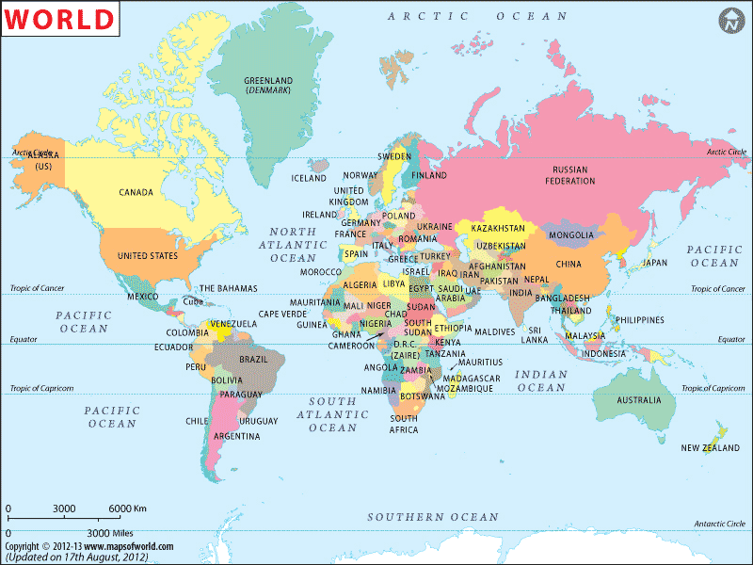

Slide 5
English Latin Greek Sanskrit
Father Pater Peter Pitr
Mother Mater Meter Matr
This similarity points to a common heritage of these languages.
The languages spoken by the people who inhabited various parts of Europe and Asia are regarded as the Indo-European languages.
Among them, the people who spoke Sanskrit came to be called as Aryans.

Slide 6
ARYANS

Slide 7
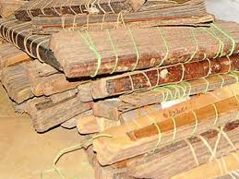
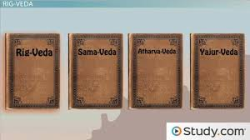

Slide 8
About 3500 years ago, Aryans arrived at the Sapta Sindhu region in the north western part of India.

Slide 9
The first literary work in Sanskrit is the Rigveda.
The Aryans were pastoralists.
Increase in population forced them to travel to other lands.

Slide 10
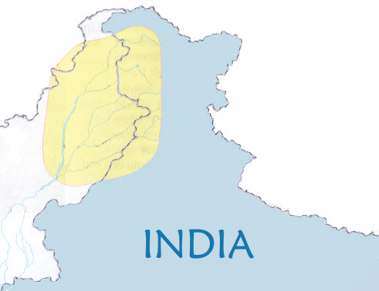

Slide 11
The Sapta Sindhu
The area including river Saraswathi together with river Sindhu and her tributaries Jhelum, Chenab, Ravi, Beas and Sutlej is regarded as the Sapta Sindhu region.

Slide 12
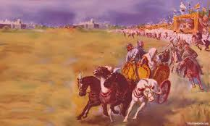
What assisted them most in their journey were the horses and the chariots pulled by the horses.
The horse skeletons and the remnants of the chariots in the paths travelled by the Aryans are evidences for their arrival.

Slide 13
Life of people
We get information regarding the life of the people in the Sapta Sindhu region from the Rigveda.

Slide 14
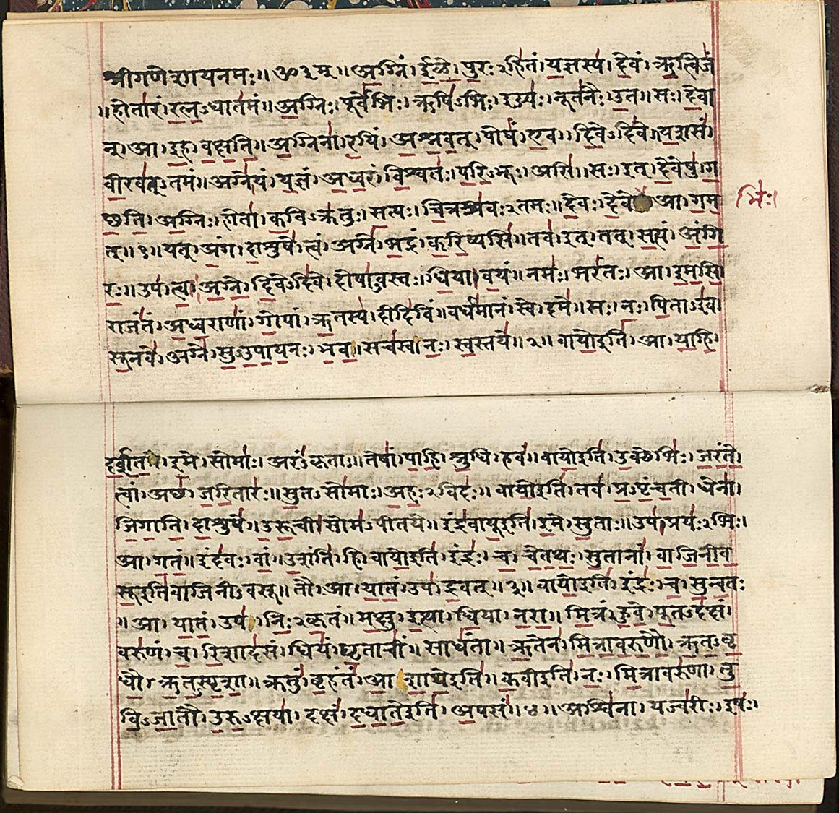


Slide 15
Aryans belonged to different tribes.
Each tribe comprised of many families.
The eldest member of the tribe was selected as the head of the tribe.
There were different tribal assemblies to assist the tribal heads. These assemblies were known as Vidatha, Sabha and Samithi.
The main occupations of the Aryans was cattle rearing and farming.
They fought battles for pastoral grounds and cattle.

Slide 16
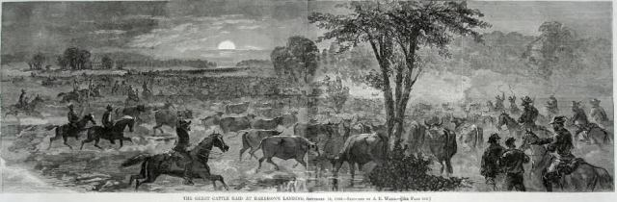
Gavishti
The battles fought by the Aryans for cattle and pastoral grounds are known as gavishti.

Slide 17
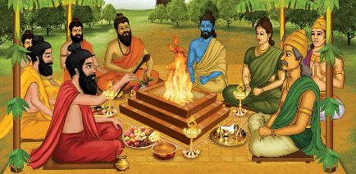
The priests who conducted sacrifies (Yagas) to ensure success in battles and the tribal heads who led the Aryans in war amassed more and more wealth.
Thus, control over wealth came to these people.

Slide 18
Rigvedic Society
priests
soldiers
common people

Slide 19
Belief System
During their period the beliefs of the Aryans were simple and based on nature worship.
Their main deity was Lord Indra.
They also worshipped other Gods, namely Agni, Varuna, Maruthi and Surya.
They also undertook various rituals and special prayers for increasing their cattle wealth.

Slide 20
Towards the Gangetic plain
By B. C. E 1000, the Aryans started moving towards the Gangetic plain.

Slide 21
What might be the reasons for this?
Increase in population
Using of Iron Tools
Possibility of Agriculture
Fertility of soil

Slide 22
The Aryans migrated to the areas adjoining the gangetic plain by clearing the forests.
Tools made of iron helped them a lot in this

Slide 23
We get information regarding the life of the Aryans from 1000 to 600 B.C.E from later vedas, namely Atharvaveda, Samaveda and Yajurveda.

Slide 24
Towards an Agrarian Society
They started farming in the fields using iron ploughshares.
With the expansion of agriculture, the Aryans were transformed into a settled society.

Slide 25
The place where the nomadic people started to settle permenantly came to be known as Janapada.
The head of the tribe became the king.
Kingship became hereditary.
The importance of the assemblies of each tribe diminished.
The farmers started the system of giving a part of their yield as tax to the king in return for protecting agricultural land.
It was known as 'bali' and 'bhaga'.
The society was stratified into four divisions.

Slide 26
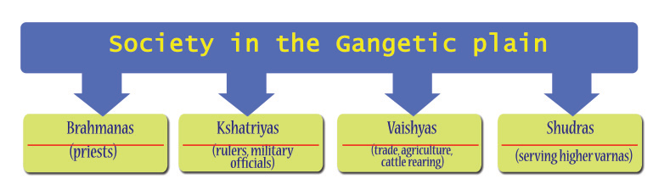

Slide 27
Belief System
Lord Indra and Agni lost their prominence.
The Gods like Prajapati and Vishnu became more and more important.
Simple rituals and practices gave way to complicated and complex ways of worship.
Means of worship and religious practices including the sacrifice of animals became costly.
The priests became more powerful.

Slide 28
Rice of Cities
The fertility of the soil and the use of iron made the Gangetic plain a better agricultural land.
This facilitated surplus production and also the growth of exchange centres.
These exchange centres later developed into cities.

Slide 29
The most prominent cities were Rajagriha, Sravasthi, Vaishali, Benares, Kushinagara and Kausambhi.
Trade routes connecting these cities came into existence.
Coins began to be used for the exchange of goods.

Slide 30
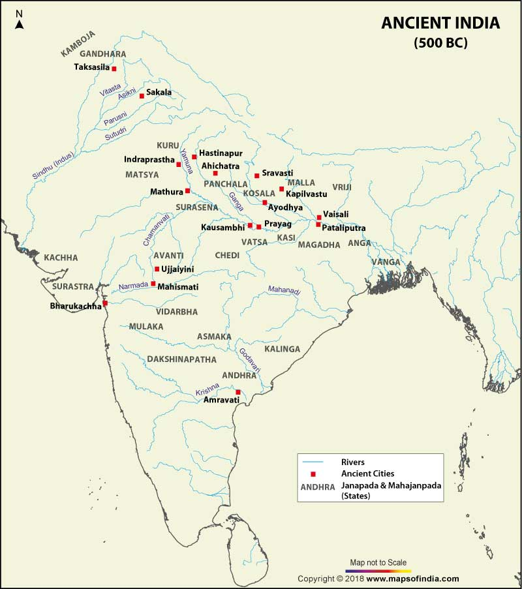

Slide 31
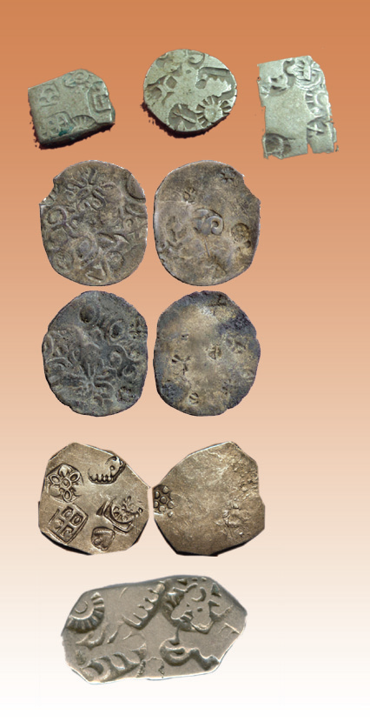
Coins are of different shapes. Punch marked coins.

Slide 32
Formation of new ideas
The social changes stated above influenced the thoughts of the people.

Slide 33
What factors might have prompted these changes in peoples thoughts ?
The increase of yagas and the animal sacrifice in association with them adversely affected the progress of agriculture.
With an increase in rituals and sacrifices, the priests started amassing wealth and thereby, exerted supremacy over others.
With the growth of trade and cities, the Vaishyas became wealthy. Though they were wealthy, they were placed in a lower position in the society.

Slide 34
Sramanas
Against this societal structure, various streams of thought emerged in the north eastern region of India.
Followers of this stream of thought were known as the Sramanas.
They began to follow Buddhism and Jainism.
The Ajivikas and the Charvakas also belong to the category of the Sramanas.

Slide 35
The Ajivikas belonged to an ancient Indian sect of naked wandering ascetics who believed in karma, fatalism and extreme passivity. ... The Barabar caves belonging to the Ajivika sect are located in the state of Bihar

Slide 36
Charvaka, originally known as Lokāyata and Bṛhaspatya, is the ancient school of Indian materialism. Charvaka holds direct perception, empiricism, and conditional inference as proper sources of knowledge, embraces philosophical skepticism and rejects Vedas, Vedic ritualism, and supernaturalism.

Slide 37
Jainism and Buddhism

Slide 38
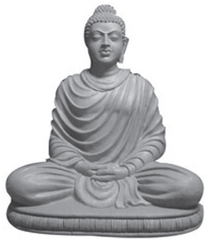
Buddhism
" I do not know the mystery of God But I know the misery of man.'
Sri Buddha

Slide 39
Ideas…
Gave importance to human beings
The most important of the tenets was Ahimsa.
Gave importance to one's own karma.
Buddha said that life if full of miseries and that the cause of all suffering was human desire.
He stated that prayers and rituals or practices of any kind would never put an end to this suffering.
Hence, rather than ritualistic practices, Buddha gave importance to the moral lives of people.

Slide 40
Books
The Tripitakas, written in Pali language, comprise the main tenets of Buddhism.
The Tripitakas
Vinaya Pitaka
Sutta Pitaka
Abhidhamma Pitaka

Slide 41
art and architecture
For spreading Buddhism, many caves, chaityas (temples), viharas (monasteries) and pillars were built.
These are evidences for the progress in the field of art and architecture.

Slide 42
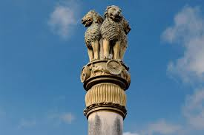
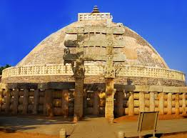

Slide 43
Buddhism also played a major role in promoting trade and culutral relations between India and neighbouring countries.
Countries like Myanmar, Japan, China, Srilanka, Java and Sumatra became the main centres of Buddhism.
The Buddhist viharas played an important role in the progress of education in India.
The universities of Nalanda, Taxila and Vikramasila were key centres of education and Buddhist teachings.

Slide 44
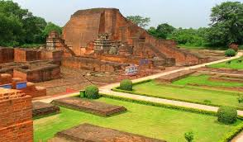
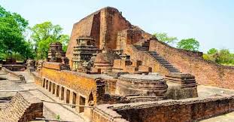
Nalanda

Slide 45
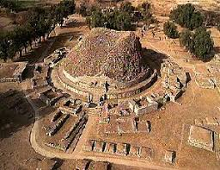
Taxila

Slide 46
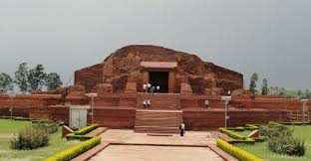
Vikramsila

Slide 47
Decline
The revival of vedic religion adversely affected the progress of Buddhism.
Buddhism lost its grandeur when it was split into two sects –
the Mahayana and
the Hinayana.

Slide 48
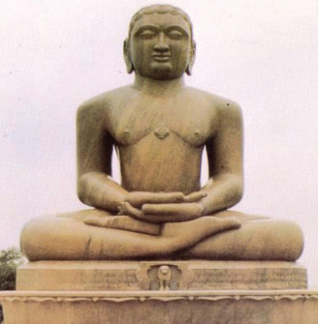
Jainism
Vardhamana Mahavira,
a contemporary of Sri Buddha, propagated Jainism.
According to the beliefs of the Jains, there are 24 thirthankaras.
Mahavira was the 24th thirthankara.

Slide 49
Ideas
Jainism gave great importance for ahimsa.
Opposed vedic practices and caste system
Mahavira advised the people to lead right life by following the principles of right belief, right knowledge and right action.
The Jain saints were abstained from telling lies, killing, stealing and acquiring wealth. They followed celibacy in life.

Slide 50
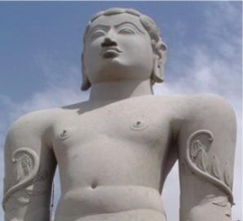
Art and architecture
Jainism encouraged construction of stone pillars, cave temples and statues.
The best example for this is the statue of Gomatheshwar in Sravanabalgola in Karnataka.

Slide 51
Decline
The separation of the followers of the followers of Jainism into Svetambaras and Digambaras resulted in the decline of the religion.

Slide 52
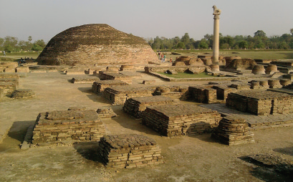
Vaishali

Slide 53
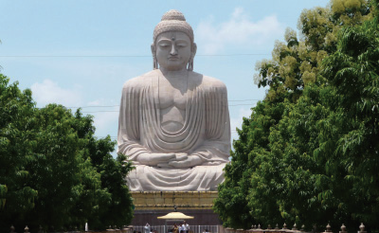
Bodhgaya

Slide 54
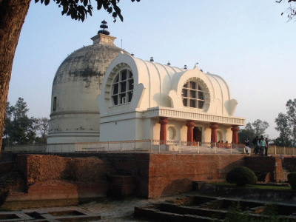
Kushinagar

Slide 55
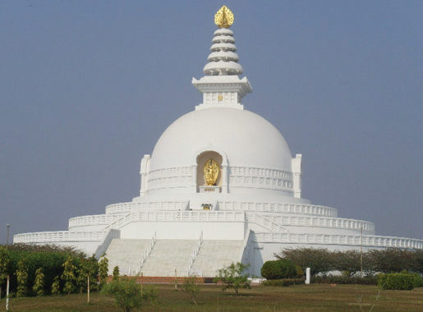
Lumbini

Slide 56
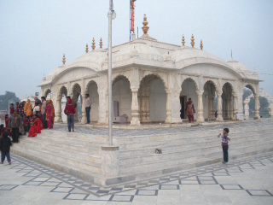
Pavapuri

Slide 57
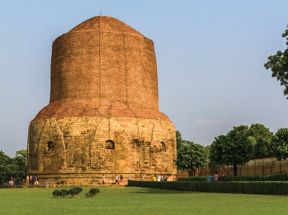
Saranath

Slide 58
Mahajanapadas

Slide 59
Mahajanapadas
With the development of agriculture, people began to settle down in a particular place.
The places where people placed their foot or where the tribe placed its foothold came to be known as Janapada.

Slide 60
Some of these Janapadas combined together to form the Mahajanapadas.
There were 16 such Mahajanapadas in the Indian subcontinent.

Slide 61
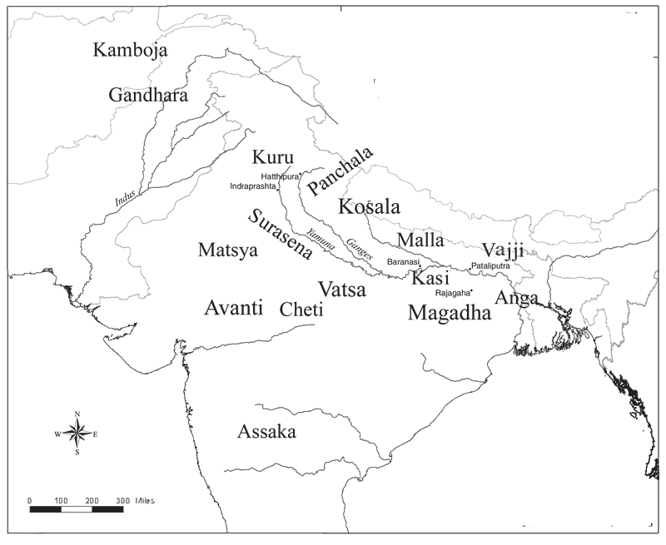

Slide 62
Administration
The Mahajanapadas were either ruled by kings or by Ganasanghas.
Mahajanapadas lying close to the Himalayan foothills had more of Ganasanghas ruling them.
Most of the Mahajanapadas in the gangetic plain were under the rule of kings.

Slide 63
Ganasangha
Groups of tribes or tribal heads are called Ganasangha.
This system of administration sustains unity based on public decision.
Administration was based on democratic principles.

Slide 64
The most powerful among the Mahajanapadas was Magadha.
What might be the reasons for their supremacy?

Slide 65
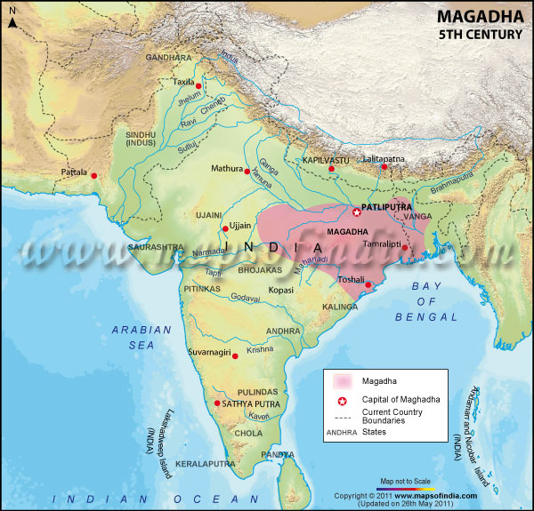

Slide 66
Rich deposits of iron ore enabled the making of weapons and farming equipments.
Ganga and her tributaries made Magadha a fertile land.
Trees from nearby forests in the Gangetic plains were used for making big boats to facilitate trade.
Made use of elephants in battles.
Progress in agriculture and commerce
Water transportation
Powerful kingship and highly efficient military.

Slide 67
The main rulers of Magadha and their clans
Bimbisara Haryanka Dynasty
Ajatashatru
Shishunagan Shishunaga Dynasty
Kalashokan
Mahapadmanandhan Nanda Dynasty

Slide 68
Foreign relations
The ruler of Macedonia in Greece came to attack India in B. C. E 327.
Alexander The great

Slide 69
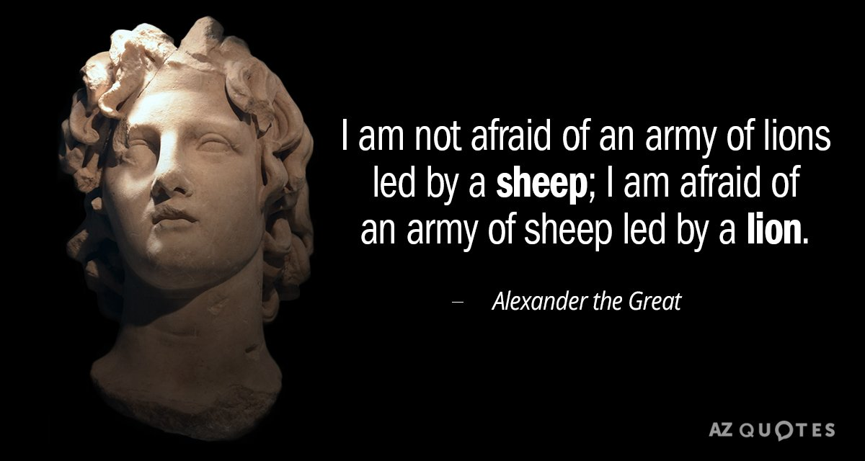

Slide 70


Slide 71
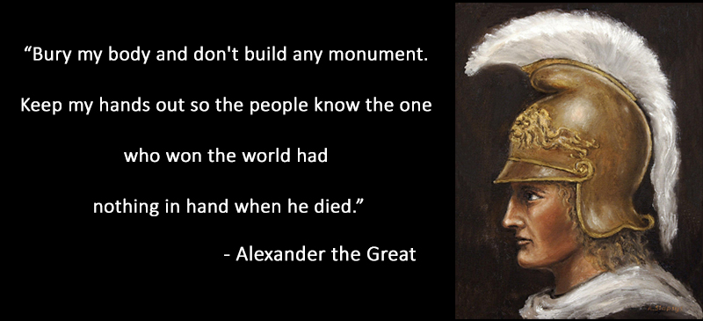

Slide 72
What are the factors that prompted Alexander to attack India?
To capture all regions under the Persian emperor.
To spread Greek culture.

Slide 73
Before the invasion of Alexander, the north western region of India were conquered by the Persian ruler, Cyrus.
Following Cyrus, Darius I attacked India and took hold of Sindh and Punjab.

Slide 74
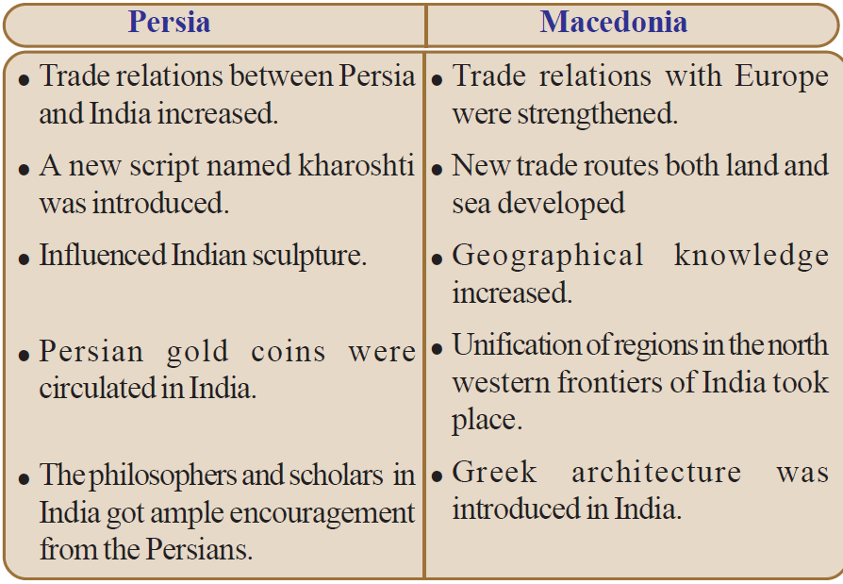
The results of the invasions of the Persians and Macedonia.

